Slide 1
SMART ATTENDANCE
By
A.Sai praneeth(10mse0066)
g.DINESH CHOWDARY(10MSE0018)

Slide 2
1.0 Abstract
We have seen over the years that the process of manual attendance has been carried out across almost all educational institutions. The process is not only time consuming but also sometimes inefficient resulting in the false marking of attendance.
we have proposed an attendance monitoring system based on the concept of web services which is implemented as an Android mobile application that communicates with the database residing on a remote server.

Slide 3
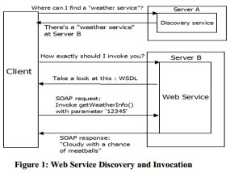
2.0 Introduction
2.1 Purpose:
The concept of Web Services is not new and has been around for many years now.
Android Operating System from Google which is supported for most of the present generation phones.

Slide 4
Contd..
2.2 Project Scope:
Latest technology in the market namely Google Android SDK .
Professor can use this application to record attendance , modify and update.
The Application has an additional feature of sending Mail or SMS to the parents if their ward is absent for 2 days and it also intimates students with a mail or SMS if their attendance percentage is less than 75%.

Slide 5
3.0 Product Perspective
3.1 Existing System:
Manual Attendance
Calculate Attendance Percentage manually
Time Consuming
3.2 Proposed System:
User friendly Android application for Attendance Monitoring.
Strong user authentication
Quick transmission of data via the web service.
Sends SMS/E-mail automatically to students with less attendance.

Slide 6
Contd..
3.3 Product Features:
It is easy to use and simpler way to upload attendance.
Sending Mail or SMS .
Helps Parents to keep track of their ward attendance.
Calculating attendance percentage.

Slide 7
4.0 Software Requirement Specification
4.1 Software Requirements:
Java (JDK 1.6)
Android SDK
Eclipse IDE
Operating System Windows 7
4.2 Hardware Requirements:
RAM : 1GB and Above
Hard Disk : 20GB and Above
Processor : Dual Core

Slide 8
5.0 Literature Survey
Title :Mobile Phone based Attendance System
IOSR Journal of Computer Engineering (Mar. - Apr. 2013)
By reading this paper, we understood the following…
Attendance through professor mobile phone.
Help the lecturers to reduce their workload by reducing the time
Including the above, our project have extra features like SMS or Mail Notifier which send a intimation to parent when their ward has less attendance.
Intimates student with warning mail when he/she absents for 2 continuous classes.

Slide 9
Contd..
Title: A Mobile Application to Access Remote Database using Web Services.
NCNTE-2012.
Android based mobile application for Attendance Monitoring is presented.
The application offers reliability, time savings and easy control.
Base for creating similar applications for tracking attendance in offices or any workplace.

Slide 10
Contd..
Title: Creating and Using SQLite Database for android applications
International Journal of Database Theory and Application
June, 2012
Overview of the Android platform towards software development.
Introduction to SQLite Database for android application.
SQLite is an Open Source Database which is embedded into Android.
Supports standard relational database features like SQL syntax.
requires only little memory at runtime.
Our project requires a database as it has to store all the attendance details of students of each day.

Slide 11
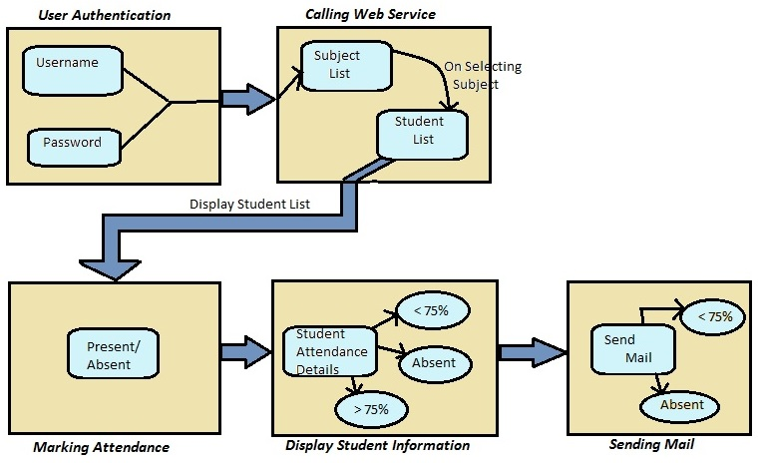
6.0 System Architecture

Slide 12
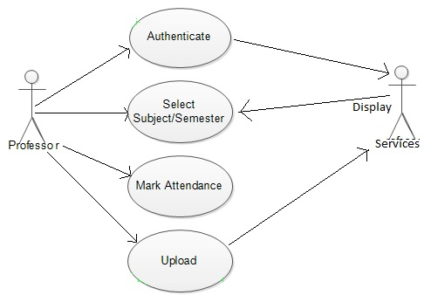
7.0 Design
7.1 Use Case Diagram:

Slide 13
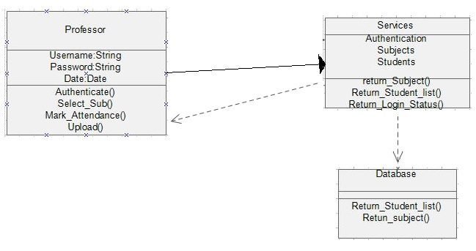
Contd..
7.2 Class Diagram:

Slide 14
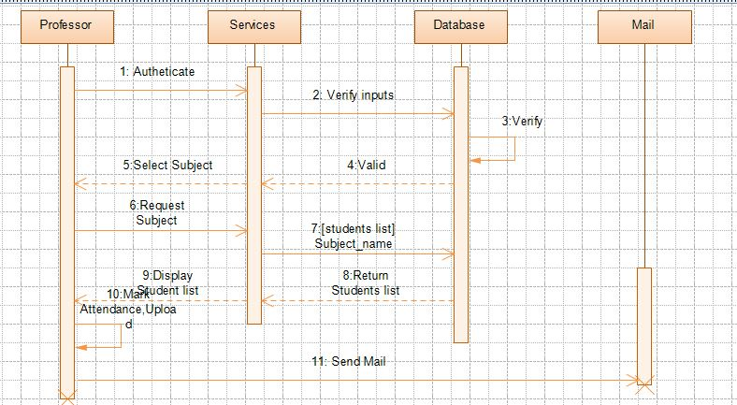
Contd..
7.3 Sequence Diagram :

Slide 15
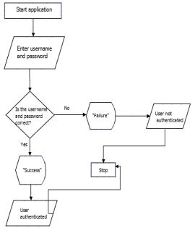
8.0 Implementation
8.1 Modules:
1.User Authentication:
Login screen - Username and Password required for authentication.

Slide 16
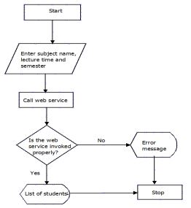
Contd..
2.Calling a Web Service :
Select Subject , Semester .
Sends request to web service.

Slide 17
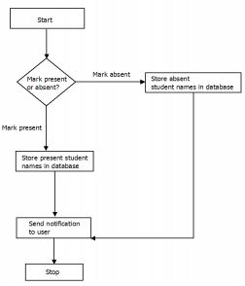
Contd..
3.Marking Attendance:
Display list of students
Mark the attendance of students.
Attendance details will be sent to database

Slide 18
Contd..
4.Display Student Information:
Attendance percentage of each student.
5.Sending Mail:
Send mail to parents about their ward attendance.
Intimates student when attendance is less than 75%.

Slide 19
9.0 References
[1] “Beginning Android 4 by Grant Allen Text Book” for basic Android application development.
[2] “Creating and using Database for Android application” by Sunguk Lee, International Journal of Database Theory and Application (Vol. 5, No. 2, June, 2012)
Link : http://www.sersc.org/journals/IJDTA/vol5_no2/8.pdf
[3] “A Mobile Application to Access Remote Database using Web Services” by Karan Balkar
Link:http://www.fcrit.ac.in/ncnte2012/library/comp_papers/paper3.pdf?.rxn=1973220
[4] “Mobile Phone Based Attendance System” by Shraddha S, IOSR Journal of Computer Engineering (IOSR-JCE).
[5] “Mobile Ubiquitous Attendance Monitoring System using Wireless Sensor Networks” by I-ChingHsu, ieee paper
Link: http://ieeexplore.ieee.org/stamp/stamp.jsp?tp=&arnumber=5529624

